Slide 1
Warlords
Group 01 COMPSYS 302 Java game project
Sylvain bechet, Mark Yep

Slide 2
Overview
Simple, fast-paced game based on Atari’s 1980 Warlords
No game experience requirement, easy to understand GUI
Simple keyboard control, no external requirements required

Slide 3
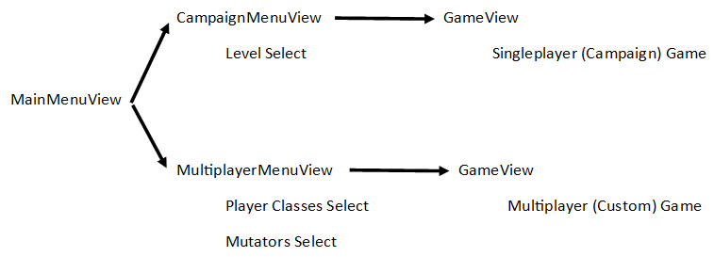
System Architecture

Slide 4

Warlords Remastered
Campaign mode (1 player)
Multiplayer mode (1-4 players)
Preview (click):
Preview (click):

Slide 5
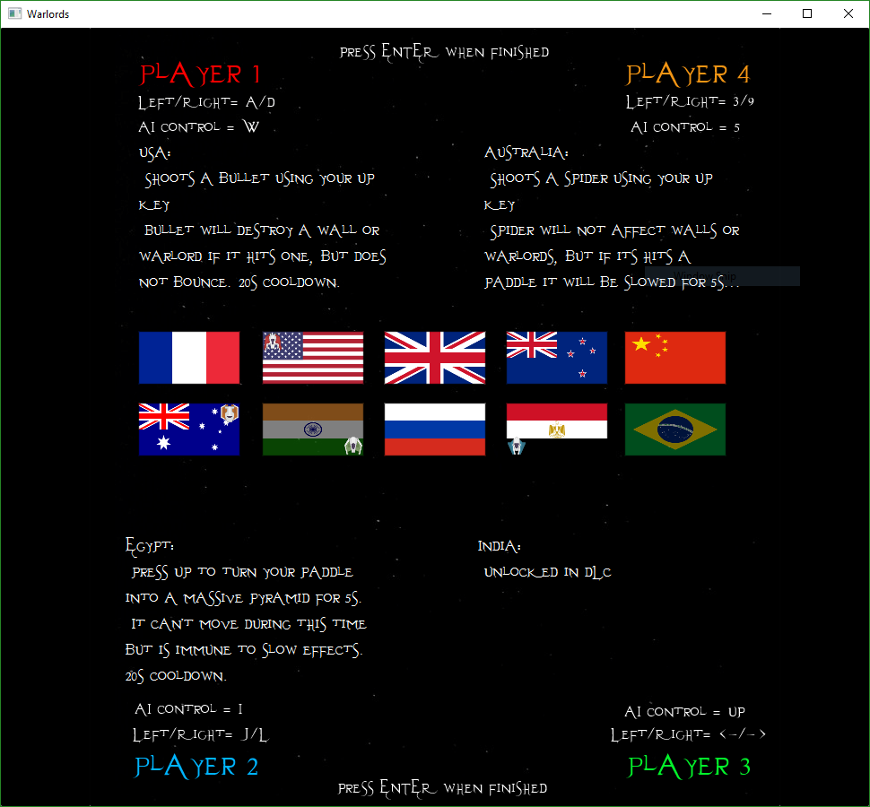
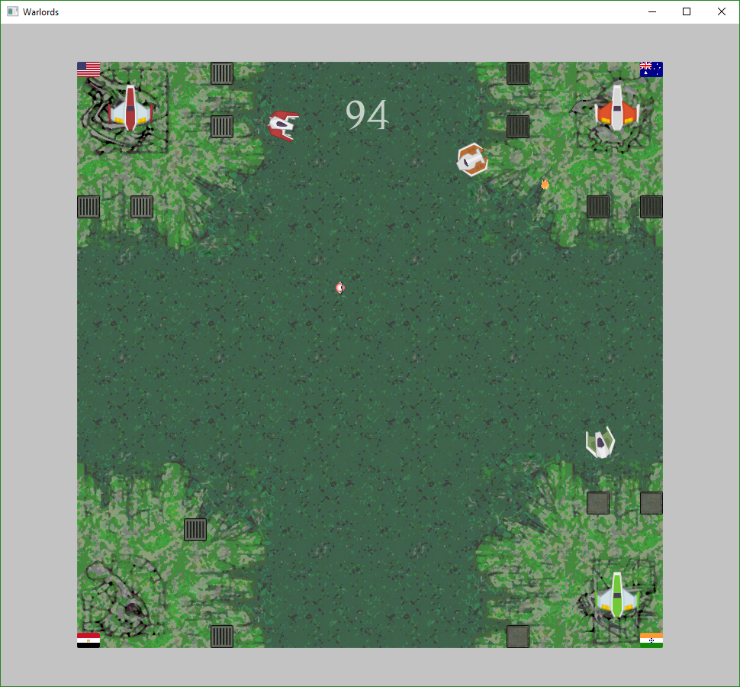
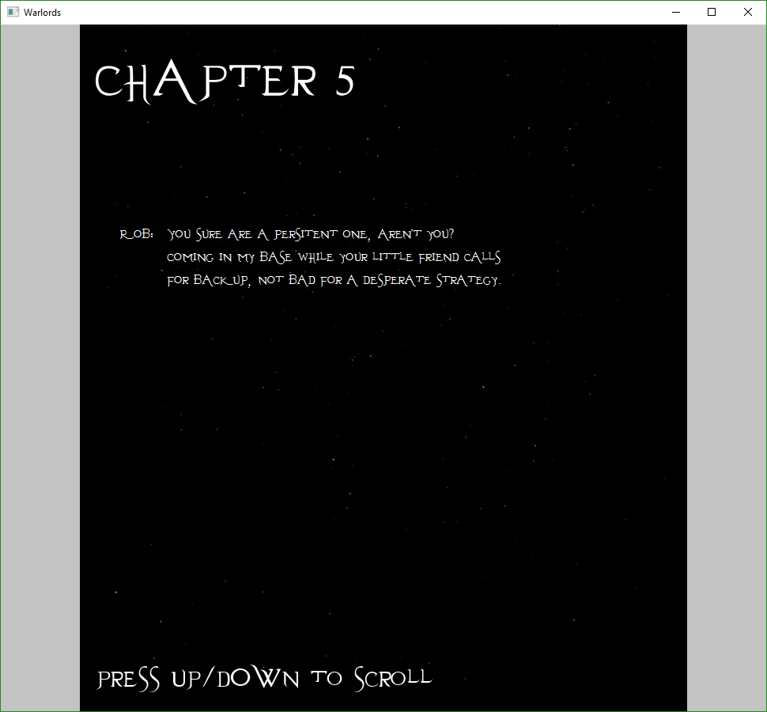
Special Features
Variety of countries with unique power ups
Modern graphics and music used fitting to the theme
A campaign mode with a captivating storyline over 8 chapters

Slide 6
Current State
Full menu functionality
Game is currently balanced and stable
Ability to easily continue developing and add more features

Slide 7
Future Possibilities
More game modes/types
Possibility of putting it online
A longer and more detailed storyline
More countries with more unique abilities

